Slide 1



ChatBot – using Amazon Lex
Darshan Nayak
Aishwarya Pathak
Ushma Desai

Slide 2
Contents
Need for a ChatBot
What is AWS Lex?
AWS Lex Pricing
Core Concepts & Terminologies of AWS Lex
Benefits of AWS Lex
Demo

Slide 3
Need For A Chat-Bot
Save human resources for qualitative tasks
Improve business branding with minimum effort
Chatbot development cost is cheap
Cost effective and time efficient
Automated customer support for similar queries
Notes:
Chatbots can be used to assist users or consumers for a specific task, whenever they want. Thus, human resources can be freed from such job and should be employed towards more productive business tasks. This will save the cost of customer support.
The competition is really getting high, and customers get inclined toward a solution that does not require much trouble. With chatbots, hitting potential customers is easy by offering required information irrespective of the day or time. Thus, providing better customer experience can help to establish a better brand.
One of the great advantages of chatbot is, it requires less development cost in comparison to application development. Well, making an investment into a quality product like chatbot is worth as it can offer a better experience to your customers.
Once you get traffic to your website, with the proper use of friendly chatbot engaging visitors becomes easy and quick. This further help to convert potential traffic into customers. This not only helps us to save the money spent on customer service labor but also the time which might have been used in apps promotion.
There are some basic questions which are required to be answered every time the customer makes the similar query. Well, for such purposes, chatbot is the best engaging way to answer these common questions.

Slide 4
What is AWS Lex?
Amazon Lex is a web service for building conversational interfaces in the software applications developed using voice and text
Provides advanced deep learning functionalities of ASR for converting speech to text and NLU to recognize the intent of the text
Key Features:
Utility prompts
Integration with AWS lambda
Lifecycle management capabilities
Multi-turn conversations

Slide 5
AWS Lex Pricing
With Amazon Lex, you pay only for what you use
You are charged based on the number of text or voice requests processed by your bot,
$0.004 per voice request and
$0.00075 per text request
So, for a bot that processes 5,000 speech requests and 2,000 text requests in a given month, you’d pay $20.00 for the speech requests and $1.50 for the text requests

Slide 6

Core Concepts & Terminologies of AWS Lex
Intent: Represents an action that a user wants to perform. Every intent has a name and utterances. An intent performs an action in response to a natural language user input. Eg: Order food, cancel booking etc
Utterances: Represents how the intent is conveyed in the chatbot.Spoken or typed phrases that invoke your intent. Eg: questions listed by the chatbot to gather user preferences.
Slots: Defines how data is organized. Slots are created in the intents. Slots can be built-in (eg: AMAZON.City) or customized slot (eg: AMAZON.Foodtype)
Prompts: Preferences/ answers given by the user
Intent fulfill: Uses lambda function
Lambda function as Code Hook- Customizes user interactions, validates user input and fulfill user intent

Slide 7
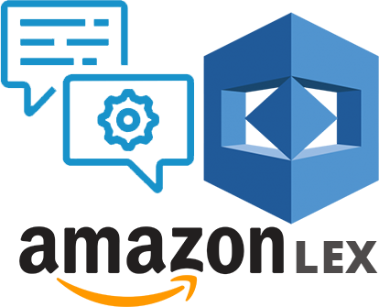
Benefits of AWS Lex
Provides easy to use console to customize chatbot
One click deployment on all channels and platforms
Seamless integrations with AWS lambda, CloudWatch, DynamoDB, etc
Cost Effective with no upfront costs or minimum fees

Slide 8
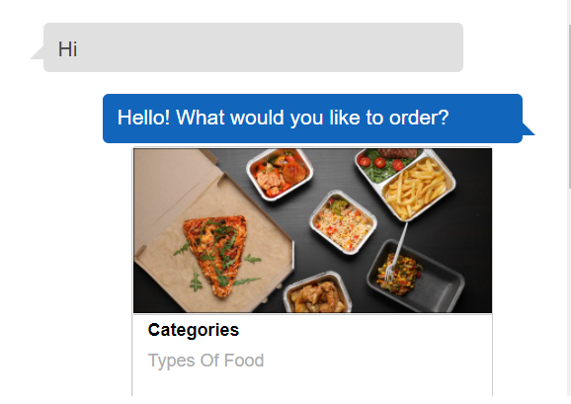
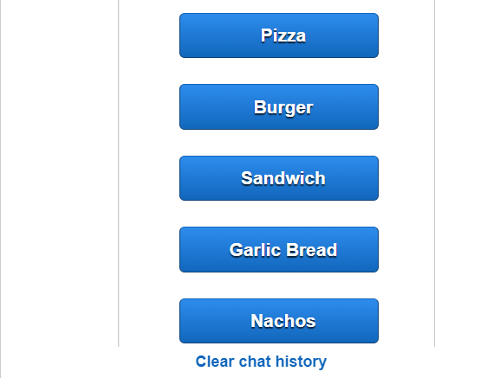
Demo

